Slide 1
Spooky SQL Show
PASS Speaker Idol 2019
William Assaf

Slide 2
Agenda of Terror
HORRIFYING nonsequential newsequentialid() GUIDs
SHOCKING foreign key behavior
TERRIFYING duplicate primary keys

Slide 3
Carnival of SQL Spookyness
Scary, frightening database sights!
Proceed only if you dare!
We are not responsible for any injuries resulting from previously existing medical conditions.
Features of night, brought to light!

Slide 4
Fright #1
Proceed only if you dare, and have never thought that using newsequentialid() is a good idea!
Behold, the terror of the newsequentialid()!

Slide 5
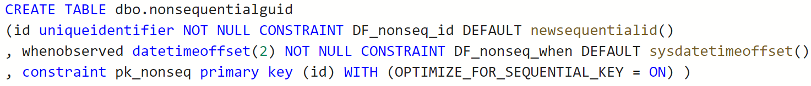
Consequential newsequentialid()
To set the stage we create a table with a uniqueidentifier column as the primary key and clustered index, using the newsequentialid() function as a default.

Slide 6
Consequential newsequentialid()
Ran some inserts, caused some things to happen, and then…

Slide 7
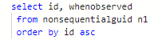
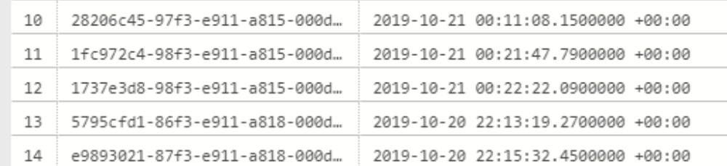
Consequential newsequentialid()

Slide 8
INSERT SORT ORDER
Expected behavior
of newsequentialid()
Actual behavior
when seed changes
Server change!
Server change!
Server change!
Server change!
Server change!
Server change!
Server change!
No Fragmentation
Fragmentation Upon Insertion

Slide 9
HowTo: Nonsequential sequential GUID
The C++ function UuidCreateSequential is based on the MAC address of the NIC.
“Never use to identify an object that is not strictly local to your computer.“
Which may rule out any High Availability or portability! Scary!

Slide 10
Nonsequential sequential GUID? How?
Any Failover in FC or AG
Upgrade or Migrate to new hardware
Upgrade or Migrate to new platform
Change the tier of Azure SQL DB
Reimage an Azure VM with ephemeral OS
Docker run without explicit MAC
Really any change to the server NIC MAC

Slide 11
MAC change could even happen on reboot!
VMWare: “The MAC address of a powered-off virtual machine is not remembered. Thus it is possible that when a virtual machine is powered on again it can get a different MAC address.” https://kb.vmware.com/s/article/219
“Hyper-V will generate an initial MAC address for the network adapter, and it will regenerate the MAC address if it believes it is necessary.” https://blogs.msdn.microsoft.com/virtual_pc_guy/2010/05/14/hyper-v-and-dynamic-mac-address-regeneration/

Slide 12
Fright #2
Proceed only if you dare, and have never thought that foreign keys were magical! Behold, the shocking truths of foreign keys!

Slide 13
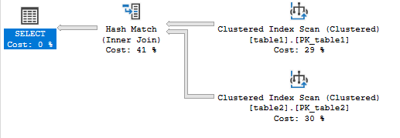
Foreign Keys Magic
I put 32000 rows in two tables.
SELECT table2.id
FROM table1 inner join table2
ON table1.id = table2.table1id;

Slide 14
Foreign Keys Magic
Now I’m going to add a Foreign Key on Table2.table1id, referencing table1.id.

Slide 15

Foreign Keys Magic
Now, keep your eye on the Scan on table1.
SELECT table2.id
FROM table1 inner join table2
ON table1.id = table2.table1id;

Slide 16
It’s Gone!
The Foreign Key allowed the scan on the parent table to vanish,
dropping the cost from 1.25 to 0.37
without changing code or indexes!

Slide 17
My Horror at SQLSat Pensacola 2012
I was giving at a lightning talk not unlike this, on night, not unlike this night…
And I could not amaze the audience with the disappearing scan trick.
Why?

Slide 18
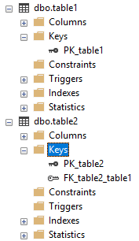
Foreign Keys Mystery
The foreign key was there…
The data was there…
Invalid inserts were disallowed…
But that second index scan just wouldn’t die.

Slide 19
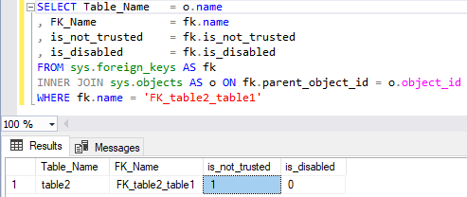
Foreign Keys Mystery
Later, I found the spook in my database.

Slide 20
Ever seen SSMS script out a FK like this?
ALTER TABLE [table2] WITH NOCHECK ADD CONSTRAINT [FK_table2_table1] FOREIGN KEY([table1id])
REFERENCES [table1] ([id]);
GO
ALTER TABLE [table2] CHECK CONSTRAINT [FK_table2_table1];
As a result, the FK exists but isn’t trusted.
It doesn’t evaluate existing rows,
and so it won’t help performance. But worse…
the second statement DOES NOTHING!

Slide 21
Mic Check Check
Instead of:
ALTER TABLE [table2]
CHECK CONSTRAINT [FK_table2_table1];
What you need for a trusted FK is:
ALTER TABLE [table2]
WITH CHECK CHECK CONSTRAINT [FK_table2_table1];
WITH. CHECK. CHECK. Seriously freaky!

Slide 22
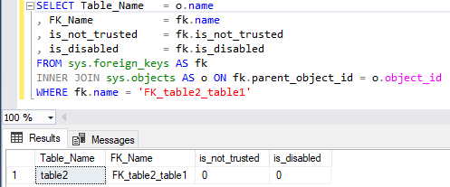
Now NOT not_trusted
FK is silently helping your queries again!

Slide 23
Fright #3
Proceed only if you dare, and have ever thought the float data type was trustworthy! Behold, duplicate primary key horror!

Slide 24
Float as PK
Many businesses have an invoice or line item or reference num system that looks like this:
YearNumInvoiceNum.LineItemNum
For example:
2019000000100.001
2019000000100.002
2019000000100.003…

Slide 25
Float is a floating point
Approximate numeric data types do not store the exact values for many numbers; they store an extremely close approximation, rounding up.

Slide 26
You Were Warned
Only use float if the max precision of decimal (38 digits!) is insufficient and you’re also ok with rounded results!
Further warnings from Microsoft Docs:
“Avoid using float/real columns in WHERE clause, especially = and <> operators.” https://docs.microsoft.com/en-us/previous-versions/sql/sql-server-2008-r2/ms187912(v=sql.105)?redirectedfrom=MSDN

Slide 27
Float as PK
Lab - float as pk problems.sql

Slide 28
Thanks for your time!
Hopefully you are all not too scared to enjoy the rest of PASS Summit 2019!

